Slide 1
HOSPITAL INFORMATION SYSTEM
Team members:
Adwait
Shalom
Fayeza
Sampadha
Sulav

Slide 2
PROJECT OVERVIEW
Purpose: Making a system that manages doctors, patients and their histories using C++ and utilizing all the different aspects of object oriented coding learnt till date

Slide 3
PROJECT OBJECTIVES
Primary Objectives:
Simplify doctor-patient record handling
Ensure efficient file saving and loading
Improve hospital data management
Key Functionalities: Add, edit, delete, and view doctors and patients.
Maintain patient history.
Memory management with dynamic allocation.

Slide 4
PROJECT MILESTONES
Milestone 1: Initial meeting, role division and planning
Milestone 2: Basic code completion and classes
Milestone 3: Patient history and file handling
Milestone 4: Final testing, debugging and documenting

Slide 5
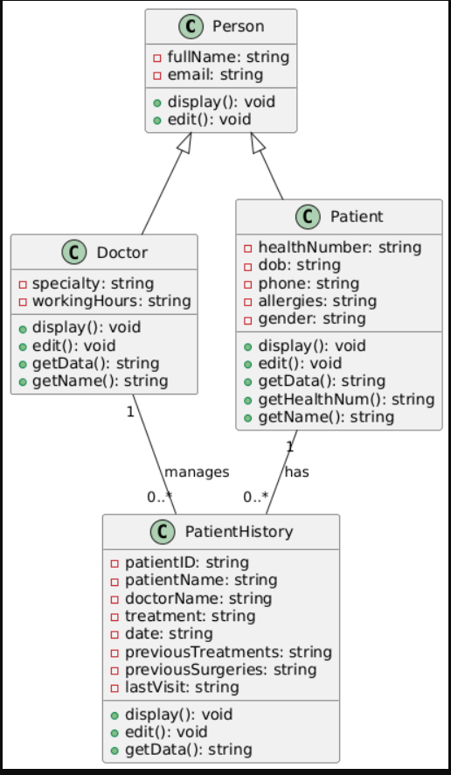
PROJECT DESIGN

Slide 6
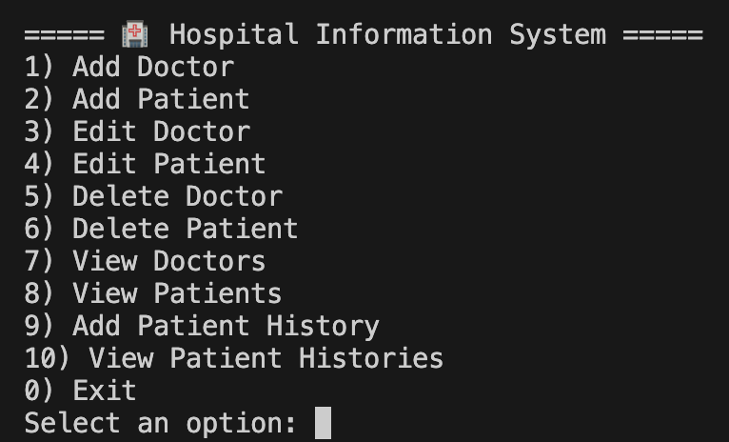
DEMONSTRATION OF FEATURES
It has multiple options for the users to choose from.

Slide 7
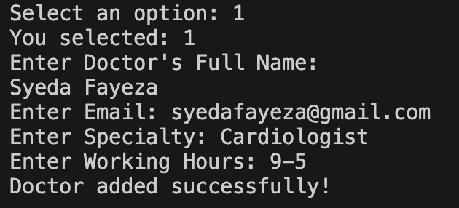
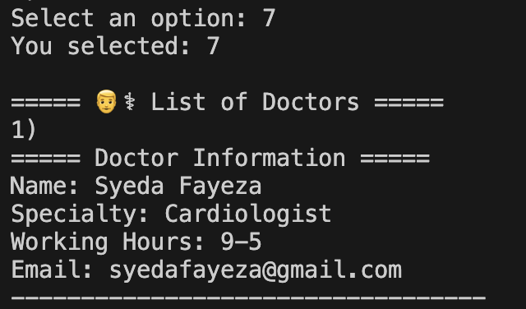
What happens when you choose an option?
Demonstration of when you choose option 1 (add doctor) :
Demonstration of when you choose option 7
(view doctors) to view the doctor you just added:

Slide 8
TECHNICAL CHALLENGES
Memory Management:
Dynamic memory handling and preventing leaks
Input Validation:
Dealing with cin() and getline() issues
Solution:
Implemented memory cleanup at program exit
Added input validation and error messages

Slide 9
TESTING AND RESULTS
Testing phases:
Individual Classes
Integration for overall functionality
Results:
No memory leaks detected after final cleanup
Successful file saving and loading
Accurate retrieval and display of patient and doctor information

Slide 10
LESSONS LEARNED
Technical Skills:
Improved proficiency in C++ file handling and memory management.
Collaboration:
Better teamwork and communication
Efficient role distribution
Problem Solving:
Overcoming memory leaks and file handling issues

Slide 11
FUTURE IMPROVEMENTS
Enhancements:
Add a graphical user interface (GUI) for better usability
Implement advanced data filtering and sorting
Efficiency:
Optimize the code for larger data
Using advanced database for storing data

Slide 12
CONCLUSION
Lot of Work
Time management was a major issue
Making a lot of mistakes mainly in file handling
Improved our understanding of C++ and teamwork as well
Tried to make as user friendly as possible in the limited time we had

